Slide 1


SHIFT 2 TEAM
SHIFT
Connecting underrepresented tech talent with companies, fostering diversity in tech.
NOVEMBER 4TH 2023

Slide 2




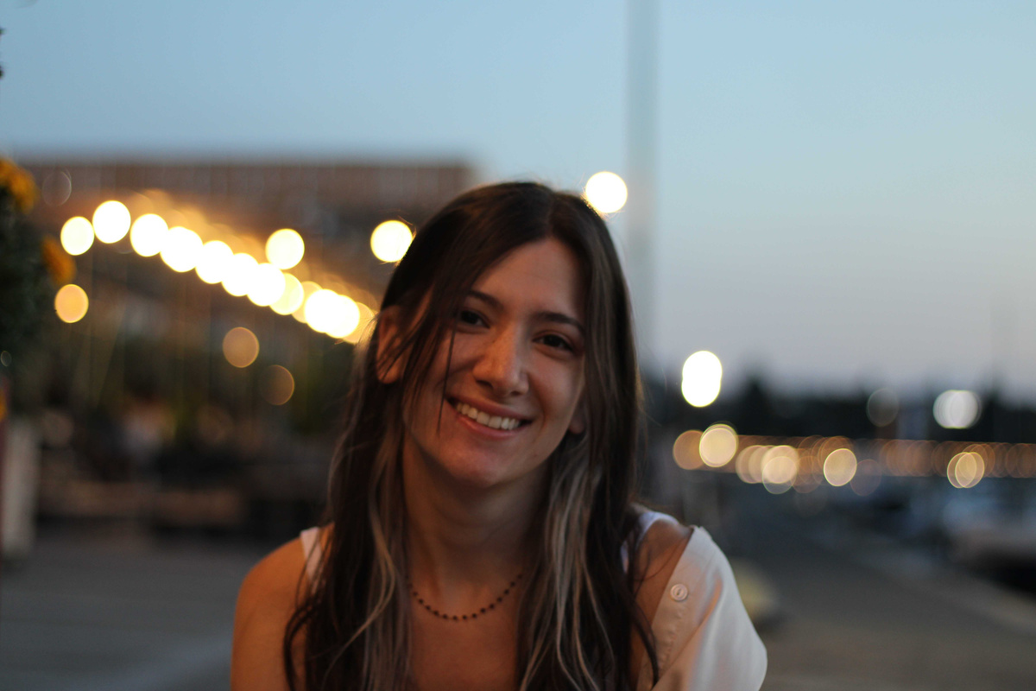
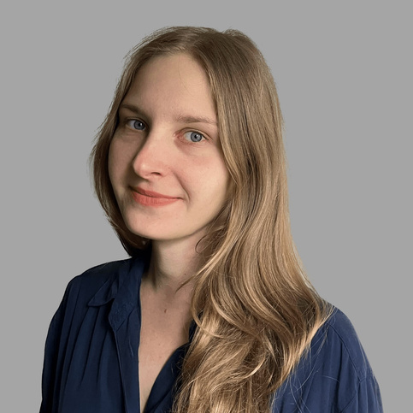
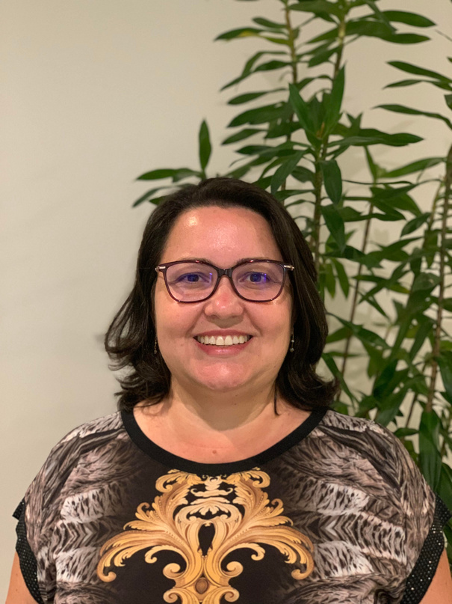

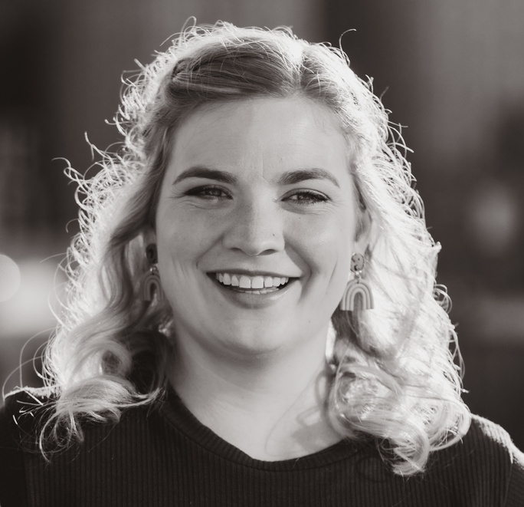
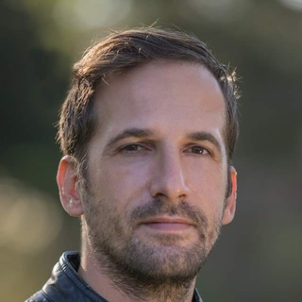
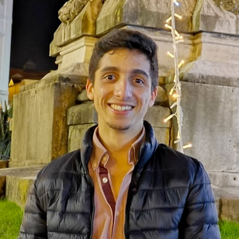
SHIFT 2 TEAM
Meet Our Team
Adamantia Milia
Adrianna Zielińska
Bianca Alves
Frontend
Backend, Data Science
Project manager
Hannah Rüfenacht
Istvan Zsigmond
João Rodrigues
UX/UI Designer
Backend
Fullstack

Slide 3


Slide 4



SHIFT 2 TEAM
Today’s Talk
01
Problem
05
Demo
02
Our Users
06
Future Steps
03
Our Solution
07
Team Learnings
04
Special Features
08
Q&A

Slide 5


SHIFT 2 TEAM
What’s the Problem?
A community of underrepresented individuals in tech, qualified for internships and entry-level positions, faces job search challenges, while companies encounter difficulties in sourcing tech talent, including those from underrepresented backgrounds.

Slide 6

SHIFT 2 TEAM
Who Are Our Users?
CANDIDATE
COMPANY
ASSOCIATION
SITE ADMIN
Streamlined job search
Values-aligned work.
Finding initial tech job
Data privacy
Identifying qualified candidates
Time limits for application and review
Need willing partners and tracking info
Challenges in upgrading CRM for program tracking
Needs simplified invitations, account deactivation, and quick profile viewing
Managing three user types challenging

Slide 7
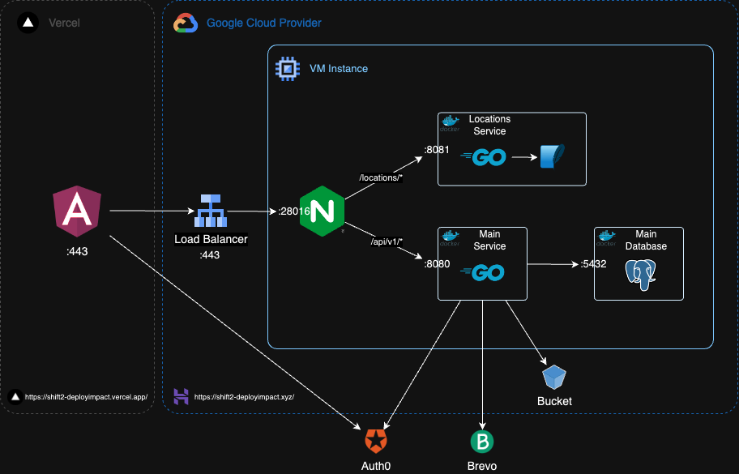
SHIFT 2 TEAM
Architecture

Slide 8




SHIFT 2 TEAM
Our Proposed Solution
Tech Stack
Simplified View for User
Accessibility
Data Privacy

Slide 9


SHIFT 2 TEAM
Special Features
Responsiveness
Light / Dark Theme

Slide 10
SHIFT 2 TEAM
Let’s Take a Look!

Slide 11
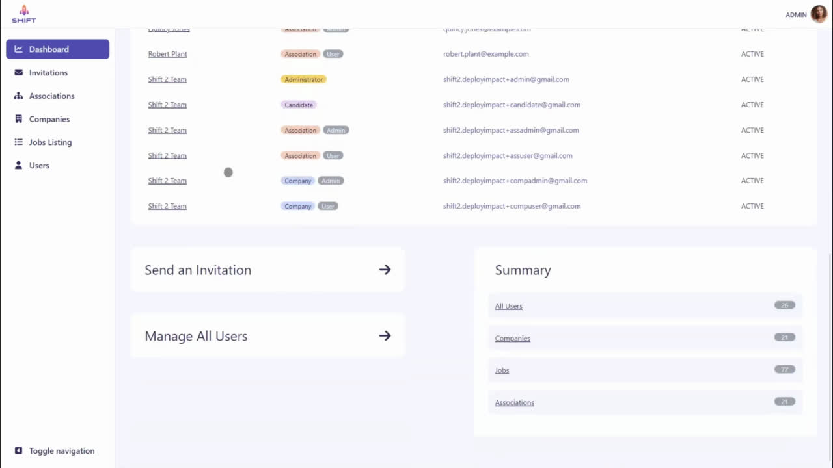
SHIFT 2 TEAM
User Management

Slide 12
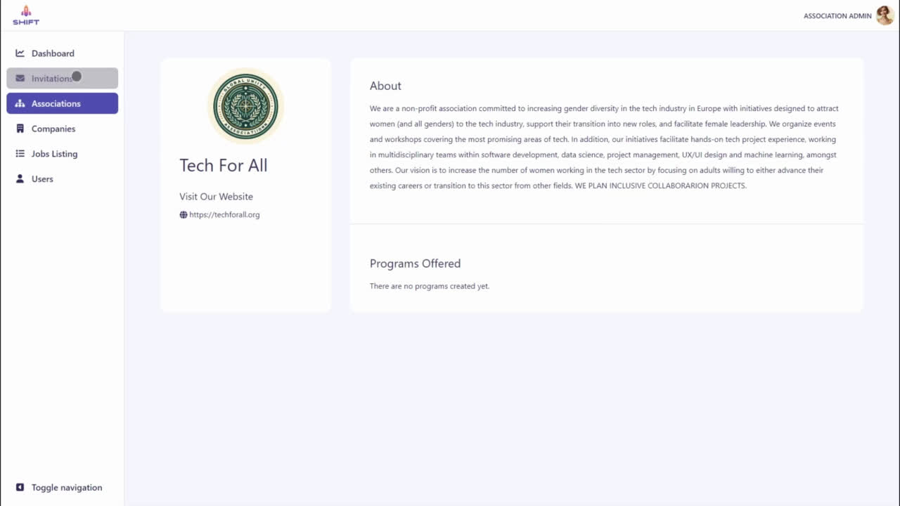
SHIFT 2 TEAM
Sending an Invitation

Slide 13
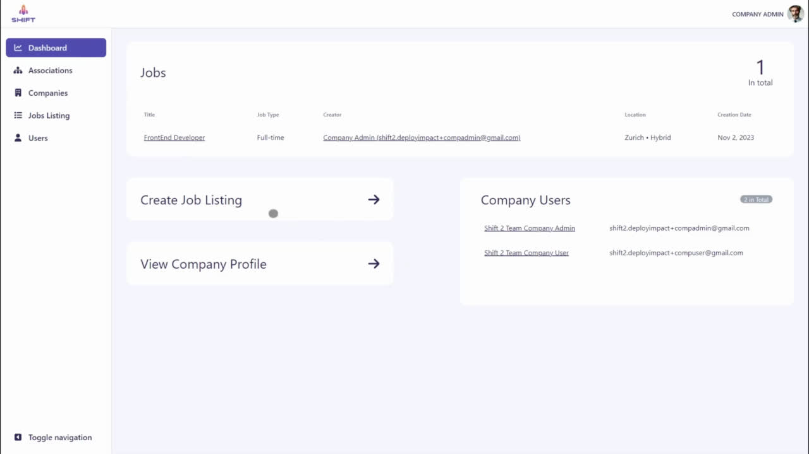
SHIFT 2 TEAM
Posting a Job Listing

Slide 14
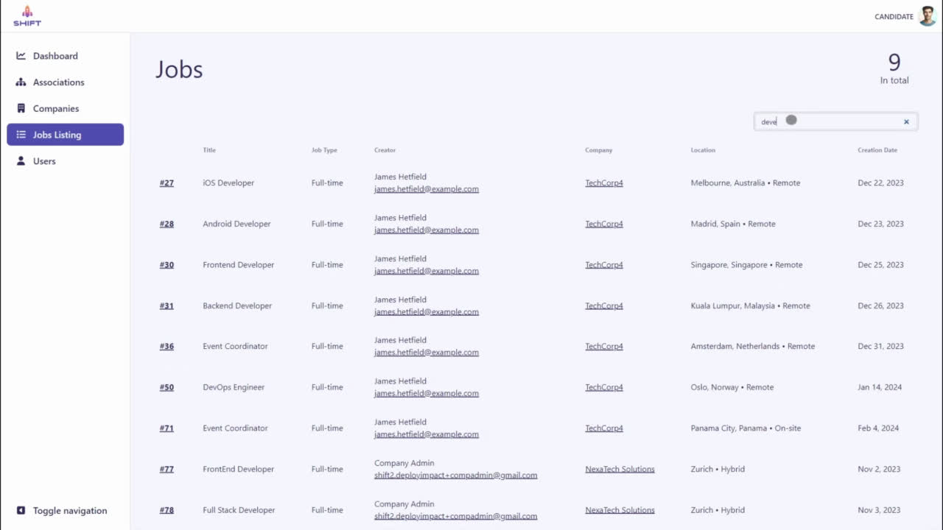
SHIFT 2 TEAM
Job Search

Slide 15
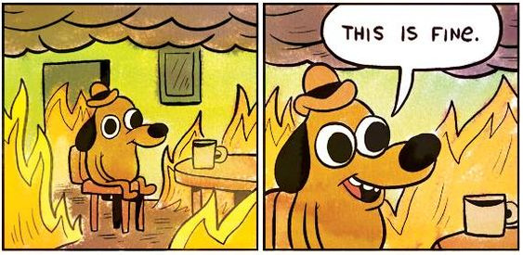
SHIFT 2 TEAM
If we had more time...

Slide 16
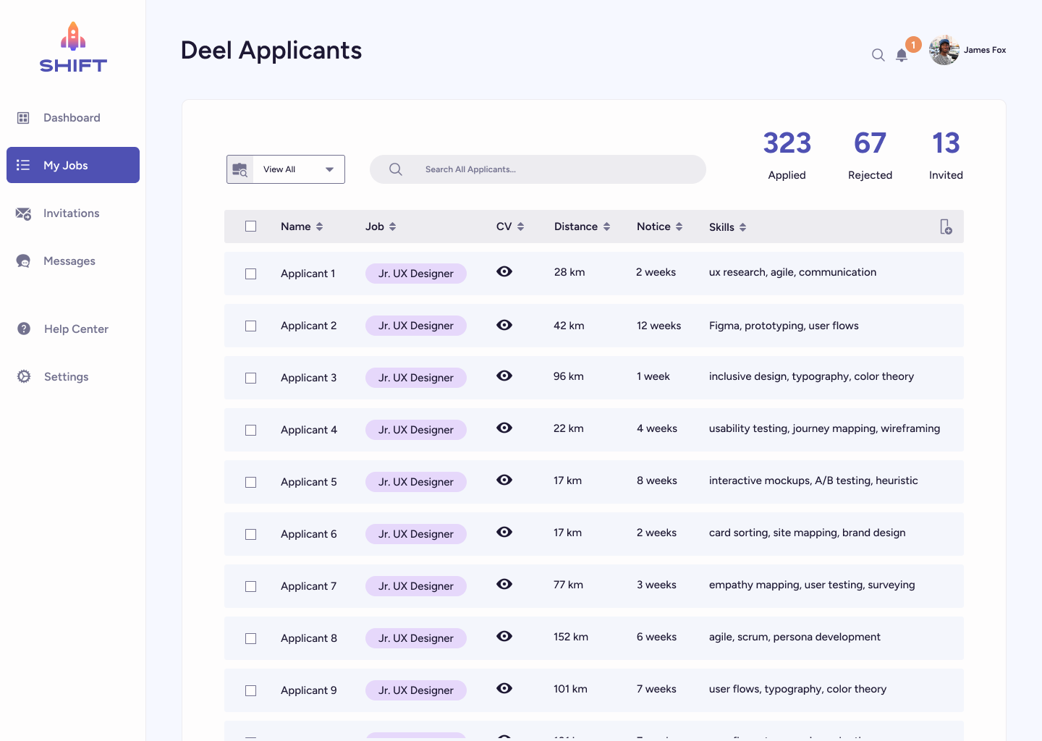
SHIFT 2 TEAM
Improve recruiter efficiency with smart candidate lists

Slide 17
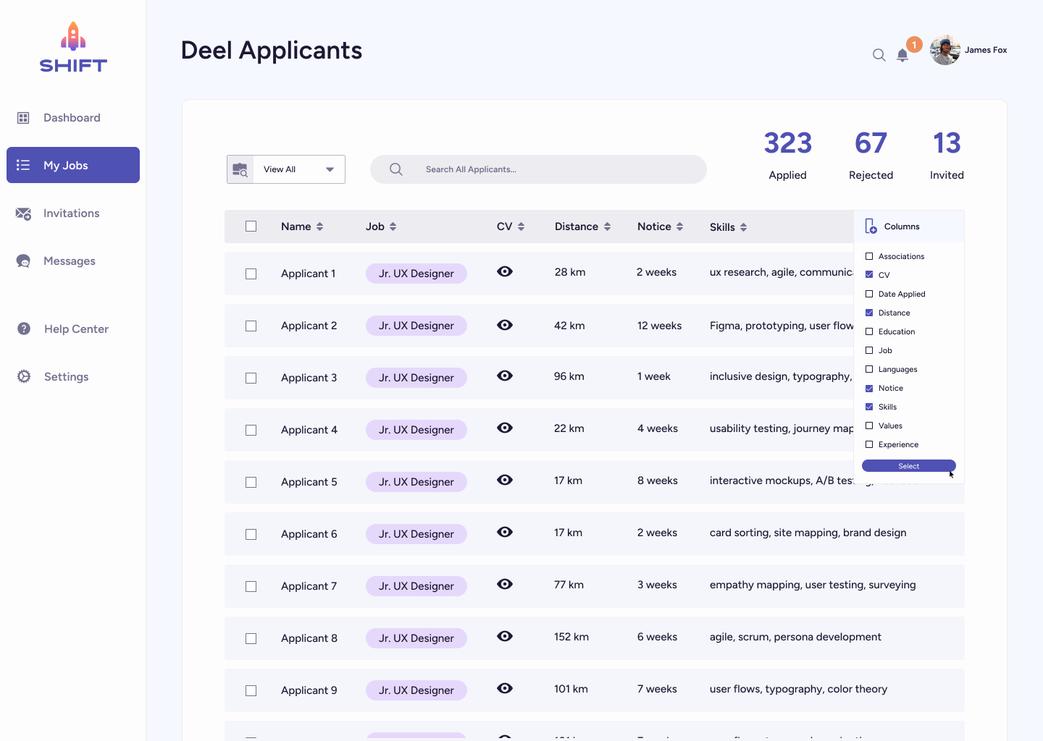
SHIFT 2 TEAM
Improve recruiter efficiency with smart candidate lists

Slide 18
SHIFT 2 TEAM
Improve recruiter efficiency with smart candidate lists

Slide 19
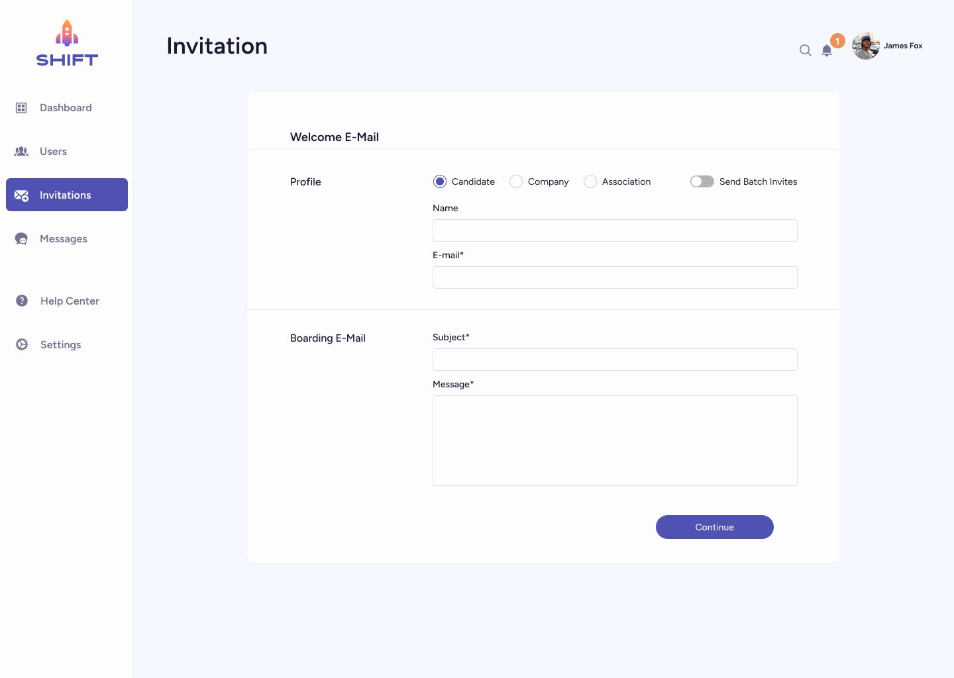
SHIFT 2 TEAM
Enable administrators to send bulk invitations

Slide 20
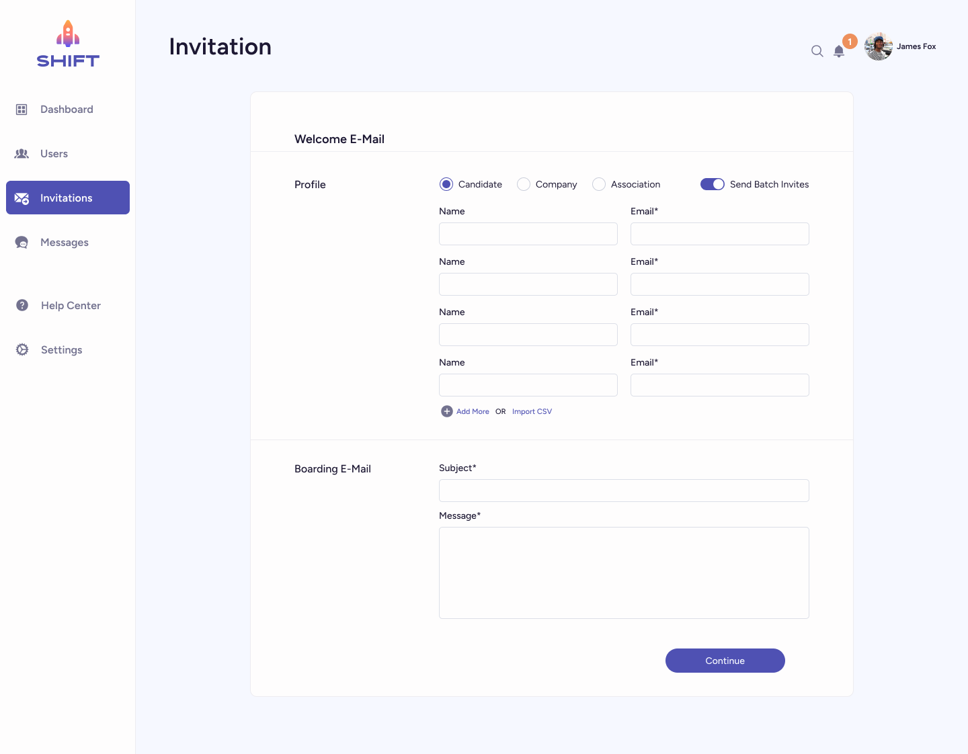
SHIFT 2 TEAM
Enable administrators to send bulk invitations

Slide 21
SHIFT 2 TEAM
Enable administrators to send bulk invitations

Slide 22
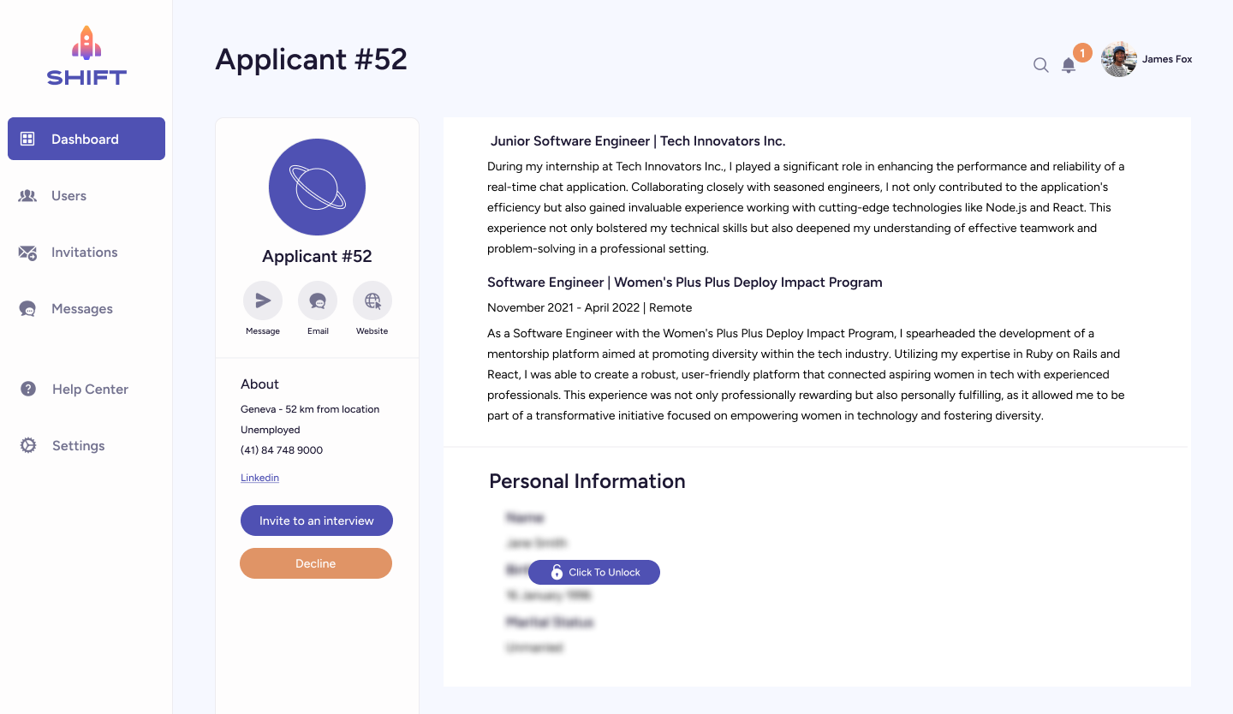
SHIFT 2 TEAM
Combat recruiter bias with blurred images and multiple clicks

Slide 23
SHIFT 2 TEAM
Combat recruiter bias with blurred images and multiple clicks

Slide 24
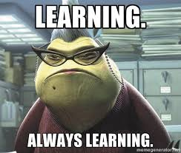
SHIFT 2 TEAM

Slide 25
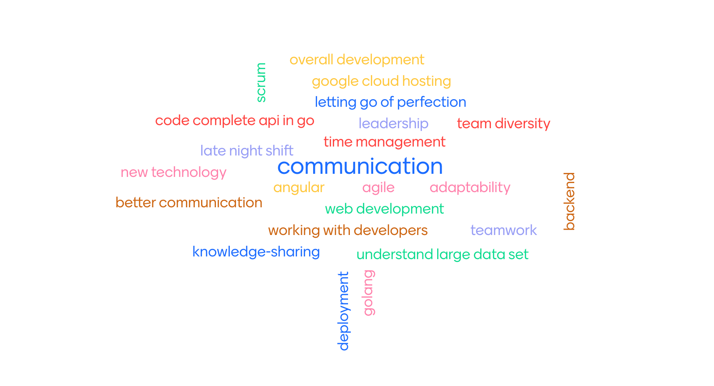
SHIFT 2 TEAM
Our Team Learnings

Slide 26
SHIFT 2 TEAM
Q&A

Slide 27
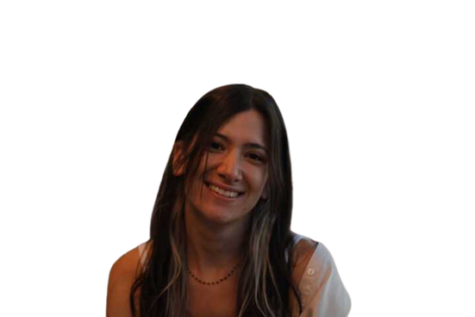

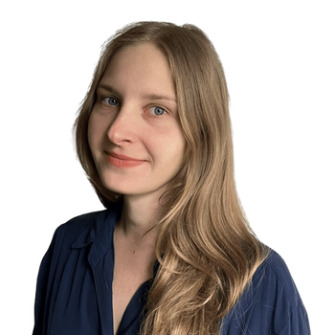
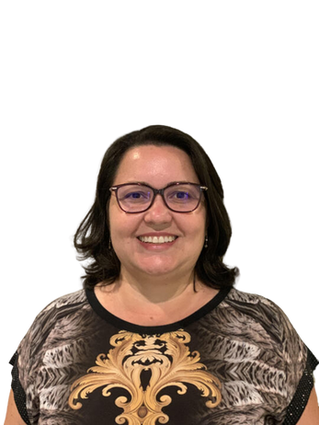
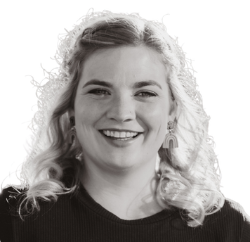
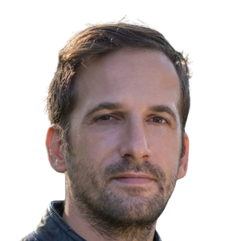
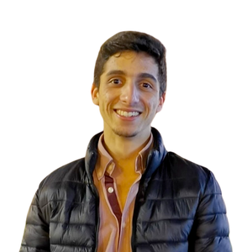
TEAM CONTACT
Adamantia Milia
Adrianna Zielinska
Bianca Alves
adamantiamilia@gmail.com
adrianna.ziel96@gmail.com
bianca.nunes@gmail.com
linkedin/adamantia-milia
linkedin/adriannazielinska
linkedin/biancaalves
Hannah Rufenacht
Istvan Zsigmond
João Rodrigues
hrufeancht.uxd@gmail.com
istvanzsigmond@aol.com
joaordev@gmail.com
linkedin/hannahrufenacht
linkedin.com/istvan-zsigmond
linkedin/joaor-dev

Slide 28
#theremainers
THANK
YOU

